Slide 1

A mysterious EngagementScore

Slide 2

Input: The fictional social network "Y" is quickly gaining traction. A mysterious EngagementScore used to rank posts in user feeds.
While initially visible in the first API version, this score has since been hidden. Fortunately,
we've managed to download some data for analysis that contains EngagementScore and other important metrics.
Task: 1. Understand the Algorithm: Determine how the EngagementScore is calculated based on various user and post feature.
2. Explore what factors influence this score.
3. Predict the Unpredictable : Assess if it's possible to accurately predict the EngagementScore for newly created posts.

Slide 3
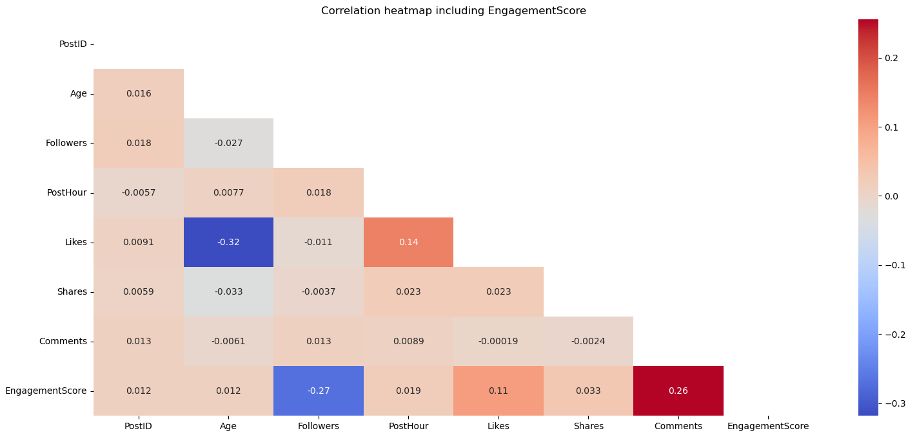
Correlation heatmap including Engagentsocre
Key Observations:
1. EngagementScore and Comments (0.26): A strong positive correlation suggests that posts with more comments tend to have higher engagement scores.
2. EngagementScore and Likes (0.11): A strong positive correlation suggests that posts with more likes tend to have higher engagement scores.
3. EngagementScore and Followers (-0.27): A strong negative correlation suggests that as the EngagementScore increases, the number of Followers tends to decrease, or vice versa. Essentially, it indicates that posts with higher engagement scores might be associated with accounts having fewer followers. This could suggest that posts from smaller accounts might engage their audience more effectively, or that larger follower counts don't always translate into proportionally higher engagement.
4. Likes and PostHour (0.14): A modest positive correlation could imply that posts published at certain hours may receive more likes.
5. Likes and Age (-0.32): A strong negative correlation, suggesting that as the Age variable increases, the number of Likes tends to decrease, or vice versa. In practical terms, this could imply that posts targeting or related to younger age groups may receive more likes, or that content resonating less with older age demographics might get fewer likes.

Slide 4
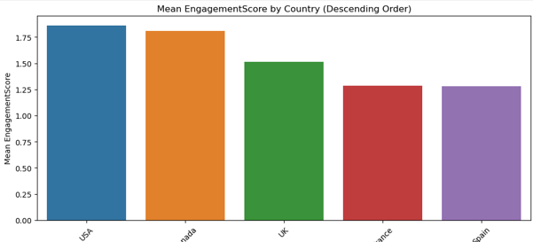
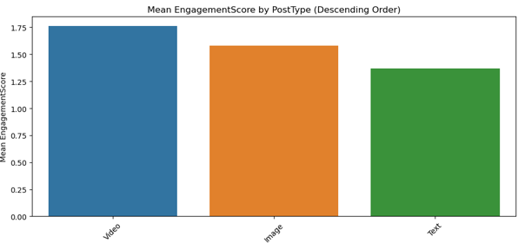
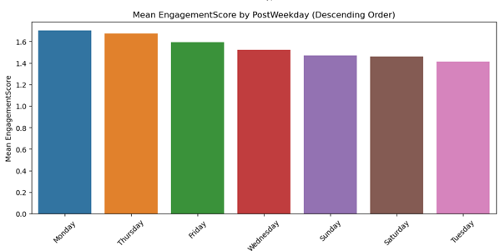
analysis of categorical features
Numerical correlation not always provides us the whole view, so let's consider some deeper analysis and see categorical features.
Categorical Features:
1. Country:
USA has the highest average EngagementScore (1.86), followed by Canada (1.81). France and Spain have the lowest averages (around 1.28).
2. PostType:
Video posts have the highest average EngagementScore (1.76), followed by Image (1.58) and Text (1.37).
3. PostWeekday:
Monday has the highest average EngagementScore (1.70), followed by Thursday (1.67) and **Friday** (1.59).
Country and PostType: The significant results for Country and PostType suggest that these features influence EngagementScore. Each group (category) has a distinct impact on user engagement.
PostWeekday: No significant differences in engagement were found between the days of the week, which might suggest that posting day isn't a major factor influencing EngagementScore.

Slide 5
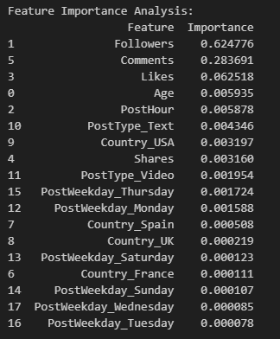
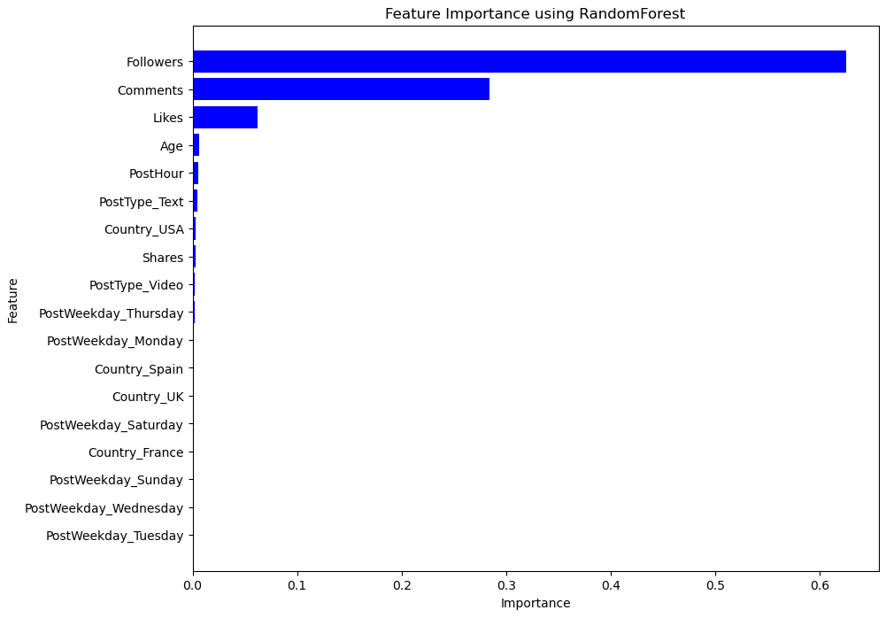
Feature Importance Analysis: Using RandomForest Regressor
Using RandomForest algorithm we can select such top numerical features:
1. Followers: The most important feature, accounting for 62.5% of the importance.
2. Comments: The second most influential feature 28.4%.
3. Likes: The third, with 6.2%.

Slide 6
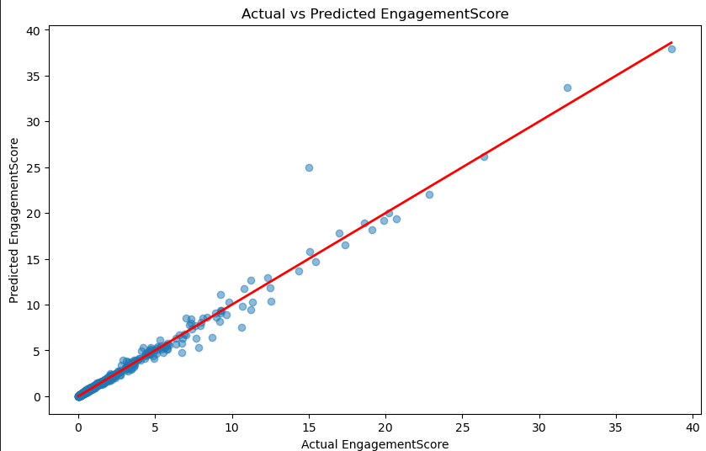

Determine how the EngagementScore is calculated
Let's build a Random Forest model with dropping such features as 'EngagementScore', 'UserID', 'PostID’.
In this model we will predict EngagementScore using such features as 'Followers', 'Likes', 'Comments' and others.
These metrics show that the model predicts EngagementScore with high accuracy, capturing over 98% of the variance. The low MSE indicates that the predicted scores are close to the actual scores.
Summary of Findings:
1. Feature Importance:
Followers, Comments and Likes were the strongest predictors of EngagementScore, suggesting that the user's follower base, audience engagement through comments and like reactions are crucial.
2. Grouping Analysis:
PostType: Videos achieve the highest engagement.
PostWeekday: Mondays and Thursdays tend to perform best.
3. Model Performance:
The RandomForestRegressor accurately forecasts the EngagementScore for new posts.

Slide 7
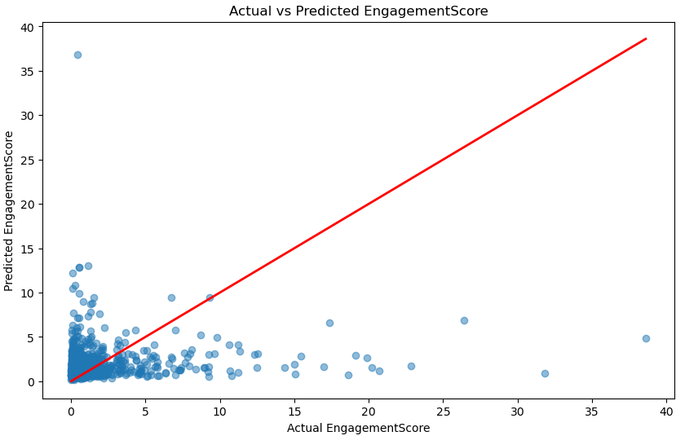

Predicting the Unpredictable
In my opinion, predicting EngagementScore without 'Followers', 'Likes', 'Comments' does not make sense, because these features have the greatest impact on this score.
When we have a new post, if there is no comment, like, or no followers, then this post will have almost zero score.
So, this post (video) should be really interesting and if people will be interested the post will receive comments, likes and followers as a result the EngagementScore will be growth.

